Slide 1
Big Mountain Resort
By Ryan Martin

Slide 2
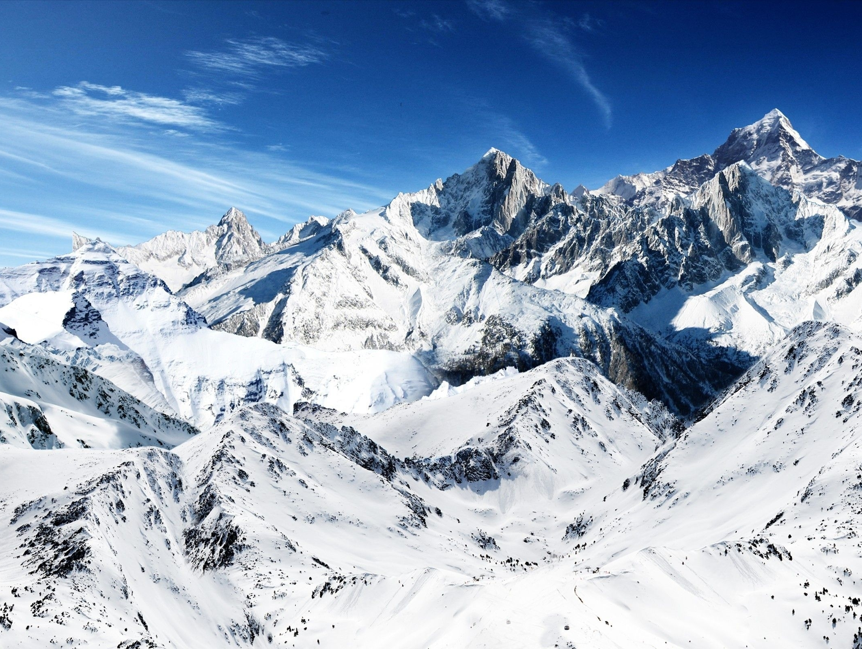
Problem Statement
S
Develop a targeted pricing strategy for the new chair lift, considering market expectations and customer value.
M
Establish benchmarks for minimizing operational costs with the recent chair lift installation ($1.54MM), while maintaining a 9.2% profit margin.
Implement realistic cost-cutting measures without compromising safety or service, and align premium pricing with the resort's brand.
A
R
Ensure that pricing strategies, cost reduction efforts, and premium pricing align with the overarching goal of increased profitability.
T
Implement pricing and cost-cutting measures before the next winter season, achieving profitability targets within the upcoming season.

Slide 3
Recommendations
Optimize Ticket Pricing
reducing operational costs
continuous monitoring & adjustment
Target
Specific Solutions
Increase Vertical Drop
Gradual Run Closure
Customer Feedback
ADDITIONAL Chair Lift
Data-Driven Approach

Slide 4
Best Machine Learning Model
Random Forest Regression
Linear Regression
Model
Performance Metric
Mean Absolute Error
Mean Absolute Error
Result
~10.5 Units
~ 9.72 Units

Slide 5
$2.22
Ticket Optimization
Price Ticket
Original:
New Features Increase:
New Price :
vb
Potential Profit
Total Revenue
$3.8MM
$81
Add Additional Chair Lift
+
1
$2.22
Increase Vertical Drop
150 ft
$83.22

Slide 6
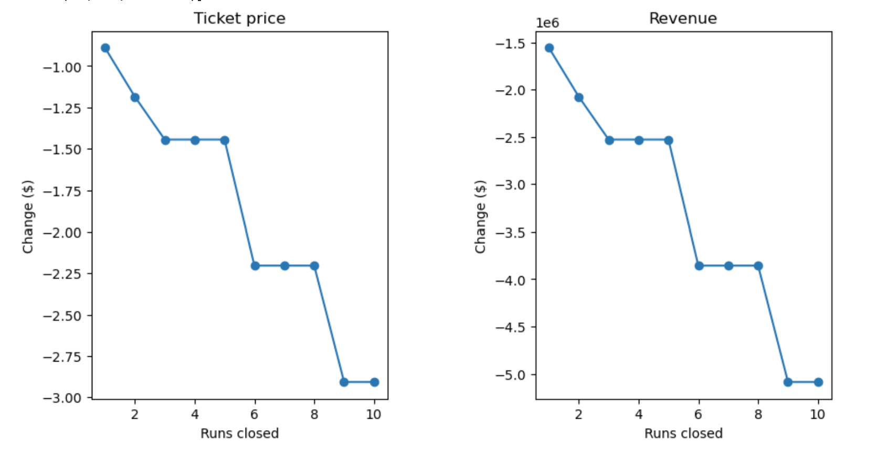
Reduce Operational Cost
Run Closure
one run makes no difference.
2-3 Causes loss of support
Closing 4 or 5 runs shows no additional loss in ticket price.
Closing 6 or more runs leads to a significant drop in ticket prices

Slide 7
Continuous Monitoring & Adjusting
Customer Feedback
Attendance
Financial Performance
Market Trend
Data-Driven Approach

Slide 8
Final Thoughts
Total Operational Expense
($1.54MM)
Net Revenue From New Features
$3.88MM
Total
$2.34MM
Big Mountain Resort's changes aim to break even and boost revenue by $2.34MM.
Note: the model did not predict a reduction in operational costs.

Slide 9
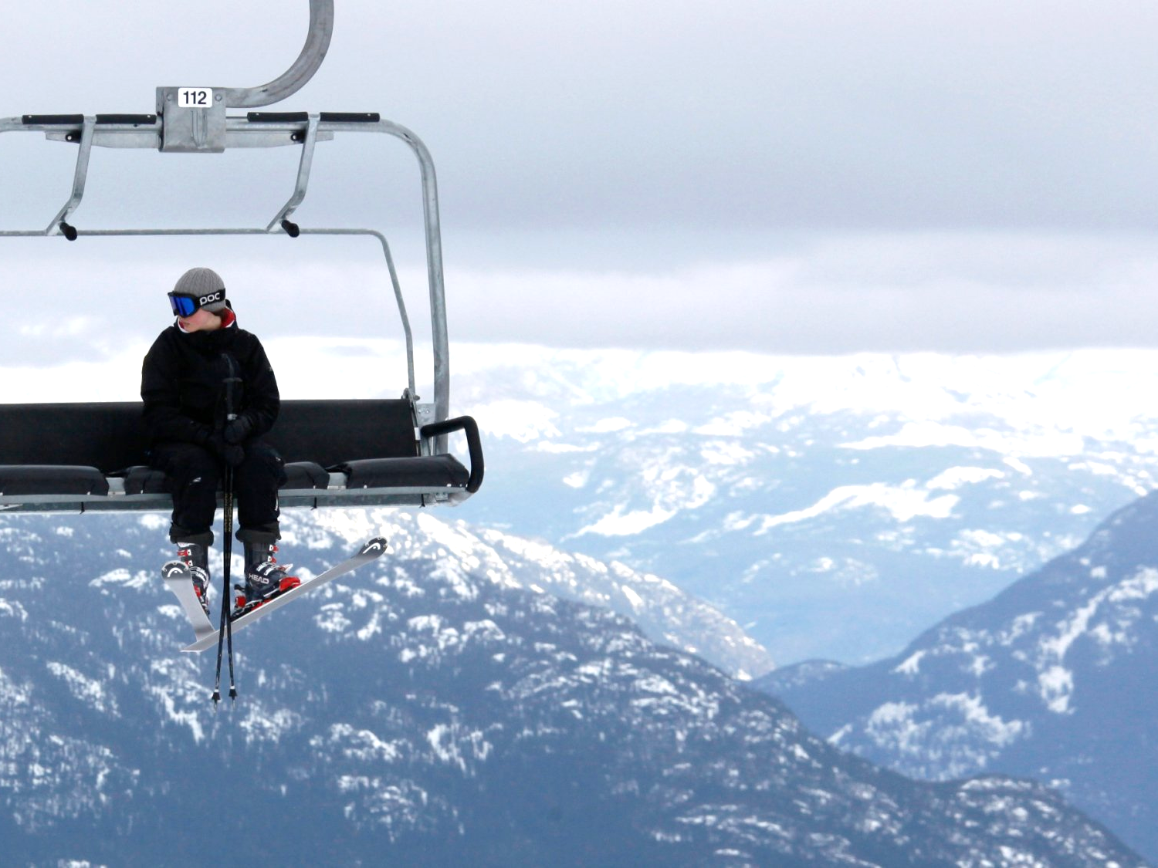
Thank You!
Thank For Coming

